Slide 1
English
Grade III
Sreenithi.S

Slide 2
Negative sentences
A negative sentence is a sentence that states that something is false. In English, we create negative sentences by adding the word 'not' after the auxiliary, or helping, verb.

Slide 3
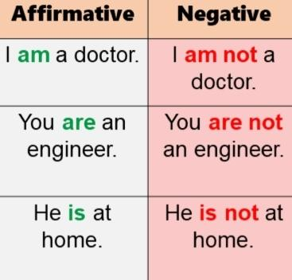
Examples

Slide 4
Thank you

